Slide 1
Ephemeral Guard AI
Ephemeral Cloud & Kubernetes Risk Detection Platform
Detect. Correlate. Respond. Before it's too late.
Bhavana B, R V College Of Engineering
Ephemeral Cloud & Kubernetes Resource Risk Detection

Slide 2
The Problem
A cloud-native enterprise runs 500+ Kubernetes workloads and provisions hundreds of ephemeral cloud resources daily — CI/CD job pods, spot instances, temporary IAM sessions and containers. These assets exist for minutes to hours, then disappear. Traditional security controls (quarterly scans, daily inventory syncs) were never designed for this tempo.
Ephemeral cloud resources exist for minutes—but attackers need even less time

Slide 3
The Problem
Cloud environments spin up and tear down in seconds — traditional security tools miss threats in ephemeral infrastructure
Security teams are drowning in raw logs across Cloud, IAM, and Kubernetes — no unified view
Most tools alert on individual events, not attack chains — attackers exploit.
Mean time to detect (MTTD) for cloud attacks is still measured in days, not minutes

Slide 4
What is EphemeralGuard AI?
An AI-powered security detection and investigation platform purpose-built for ephemeral cloud & Kubernetes environments
Ingests logs from 3 sources simultaneously: Cloud logs, IAM activity, and Kubernetes events
Converts 1,000+ raw events → 46 incidents with 95.4% noise reduction
Maps every incident to the MITRE ATT&CK framework automatically

Slide 5
Key Features
Feature | What it does
🔍 Anomaly Detection | Isolation Forest ML model trained on cloud, IAM & K8s features
🔗 Incident Correlation | Groups multi-event attack chains per user across time
⚖️ Risk Scoring | Weighted scoring (70–95) with Critical / High / Medium severity
🗺️ MITRE ATT&CK Mapping | Auto-tags T1496, T1068, T1078 techniques
🎬 Attack Replay | Step-by-step timeline reconstruction of any incident
👤 Identity Explorer | Per-user risk profile with full IAM activity history
📦 Asset Inventory | All 361 resources tracked with suspicious activity flagging
📊 Security Analytics | Detection performance, noise reduction, coverage metrics
💡 Recommended Actions | suggestions that tell the security team what should be done after detecting an anomaly or security incident

Slide 6
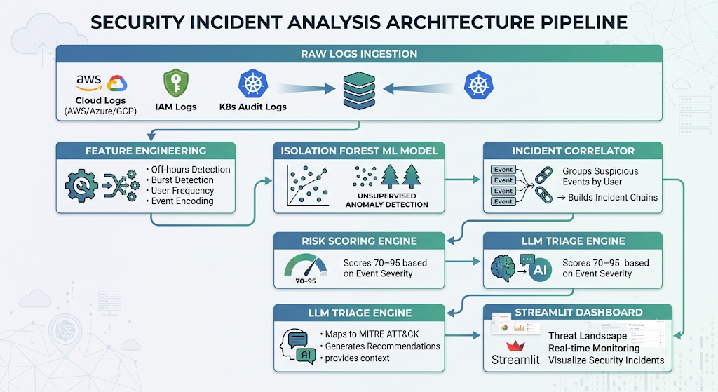
Architecture

Slide 7
What Makes My Project Different ?
95.4% Noise Reduction — 1,000 events distilled to 46 actionable incidents. Most SIEM tools flood you with alerts.
Multi-source Correlation — Combines Cloud + IAM + Kubernetes into unified incidents, not siloed alerts
Attack Chain Reconstruction — The Attack Replay page rebuilds the exact sequence of steps an attacker took
Built for Ephemeral Infrastructure — Traditional tools lose context when VMs vanish; EphemeralGuard correlates by user identity, not resource lifetime
Zero-config MITRE mapping — No rules to write; attack classification is automatic
End-to-end pipeline — Feature engineering → ML detection → scoring → triage → visualization, all in one system
Recommends Actions -- AI-generated suggestions that tell the security team what should be done after detecting an anomaly or security incident.

Slide 8
Live Demo Stats(Demo Video)
Total Events Monitored: 1,000
Unique Resources Tracked: 361
Unique Users Profiled: 50
Incidents Detected: 46
Critical Incidents: 34
Noise Reduction: 95.4%
Attack Types Detected: Resource Hijacking, Privilege Escalation, Credential Abuse, Suspicious Activity
MITRE Techniques Covered: T1496, T1068, T1078
Recommends Actions To be Taken

Slide 9
Tech Stack
Language: Python
Dashboard: Streamlit (multi-page)
ML Model: Scikit-learn Isolation Forest
Data: Pandas (Cloud, IAM, K8s CSV logs)
Visualization: Plotly / Streamlit charts
Detection Pipeline: Custom feature engineering + rule-based risk scoring
Triage Engine: Rule-based LLM-style narrative generation

Slide 10
Future Roadmap
Feature 1 — Automated Dependency Cleanup
One of the biggest unsolved problems in ephemeral security is what we call ghost permissions — when a pod dies, its IAM roles, secrets, and service accounts stay alive. That's a dangling attack surface.
On pod termination, EphemeralGuard automatically discovers and revokes all associated:
IAM roles and bindings
Service accounts
Secrets and ConfigMaps
Network policies scoped to that pod
We're building Automated Dependency Cleanup — the moment a pod terminates, EphemeralGuard maps its full dependency graph and revokes every permission it held. No orphaned roles. No lingering secrets.

Slide 11
Future Roadmap
Feature 2 — Pod Lifecycle Ledger
Every pod gets a full cradle-to-grave record:
Spin-up time, namespace, image, resource requests
All events triggered during its lifetime (API calls, network connections, secrets accessed)
Who created it, what service account it ran under
Termination reason + cleanup actions taken
every pod will have a Lifecycle Ledger — a full cradle-to-grave record of everything it did, from spin-up to deletion. Every API call, every secret it touched, every network connection — all stored as an immutable audit trail that links directly back to our incident records.

Slide 12
From 1,000 events to 46 incidents. From confusion to clarity. In seconds.
GitHub : https://github.com/Bhavanab2004/EphemeralGuardAi

